Slide 1
My Family Health Portrait (MFHP) – HealthVault Import/Export Project
Wireframe Review (Export)
Prepared for
The Department of Health & Human Services &
The National Cancer Institute
November 6, 2009

Slide 2
Overview
Wireframes for Save Family History to HealthVault
  Navigation map
  Screenshots/wireframes mockups
Placeholders for Open Family History (next phase)
Next Steps

Slide 3
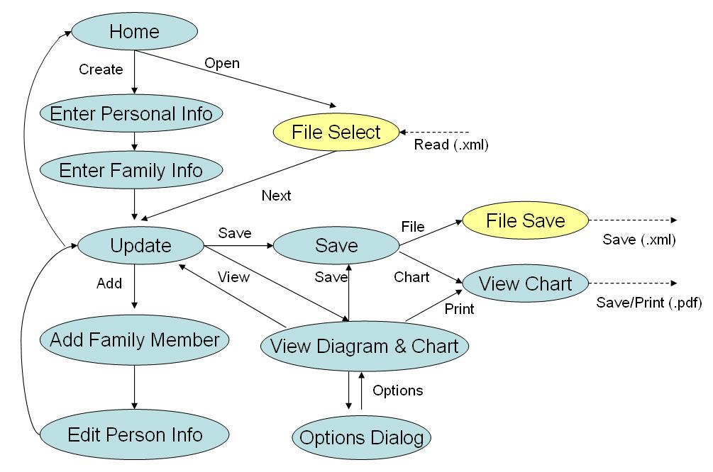
Current Navigation Map

Slide 4
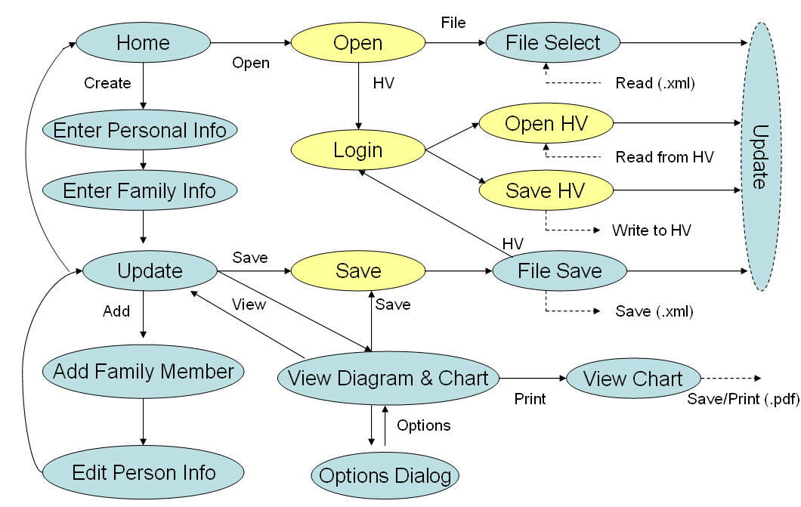
Future Navigation Map

Slide 5
Save a Family History

Slide 6
SAVE screen changes
Add link to HealthVault Manager
Change code driving the “The Family Health History file you have saved is up to date.” message to be aware of HealthVault
Eliminate link to Save Printable Chart
  Frees up space for HealthVault text
  Different kind of save
    One-way operation, more related to printing
  Feature already accessible thru View Diagram & Chart

Slide 7
Wizard version for save process

Slide 8

Save Your Family Health History
Your Family Health History information will be saved with [proband name] as the center person. To make a blood relative be the center person, first Center My Family History.
+
Show me more information on saving
1. Download Data File
2. Save Online (3rd Party)
1. Download Data File
Save to Computer or Portable Device
In this step, you can save your Family Health History to your computer or portable device as an XML data file. Your data file can be uploaded to this website later to update your Family Health History.
+
Show me more information on downloading
Download Now
(Remember where you save the file)
+
Show me detailed download instructions

Slide 9

Save Your Family Health History
Your Family Health History information will be saved with [proband name] as the center person. To make a blood relative be the center person, first Center My Family History.
+
Show me more information on saving
1. Download Data File
2. Save Online (3rd Party)
2. Save Online (using a 3rd Party Tool)
Save to Microsoft HealthVault.
Microsoft HealthVault allows you to store health information from many sources in one location, so it’s always organized and available to you online. Your Family Health History data can be transferred from HealthVault to this website later to update your Family Health History.
Save Now
Cancel/Close
(You will be prompted to sign in or create an account)

Slide 10
Alternate version for single save page

Slide 11
Save Your Family Health History
Your Family Health History information will be saved with [proband name] as the center person. To make a blood relative be the center person, first Center My Family History.
+
Show me more information on saving
Select Save Location
You can save your Family Health History to your computer or portable device as an XML data file. You can also save your information on a third-party website. Your Family Health History data can be transferred from any of these locations back to this website later to update your Family Health History.
Save to computer or portable device
+
What is this?
Save to Microsoft HealthVault
(please save to computer first)
+
What is this?
Save Now
Cancel/Close
If saving to your computer, please remember where you save the file. If saving to a 3rd party provider, you will be prompted to sign in or create an account.

Slide 12
Alternate version for multiple PHRs

Slide 13

Save Your Family Health History
Your Family Health History information will be saved with [proband name] as the center person. To make a blood relative be the center person, first Center My Family History.
+
Show me more information on saving
1. Download Data File
2. Save Online (3rd Party)
2. Save Online (using a 3rd Party Tool)
These third-party providers allow you to store health-related information from many sources online. Your Family Health History data can be transferred from these third party provider’s account to this website later to update your Family Health History.
Save to Microsoft HealthVault
Save to Google Health
Save Now
Cancel/Close
You will be prompted to sign in or create an account on the 3rd party tool.

Slide 14
Alternate version for multiple PHRs and Downloading on one page

Slide 15
Save Your Family Health History
Your Family Health History information will be saved with [proband name] as the center person. To make a blood relative be the center person, first Center My Family History.
+
Show me more information on saving
Select Save Location
Save to your computer or portable device, or select a third-party provider to allow you to store your information online. Your Family Health History data can be transferred from any of these locations back to this website later to update your Family Health History.
Save to computer or portable device
+
What is this?
Save to Microsoft HealthVault
+
What is this?
Save to Google Health
+
What is this?
Save Now
Cancel/Close
If saving to your computer, please remember where you save the file. If saving to a 3rd party provider, you will be prompted to sign in or create an account.

Slide 16
PRE-LOGIN dialog
We transfer control to HealthVault for login
But first, display warning notification that user is leaving the site
Display any connection error notifications

Slide 17


Microsoft HealthVault Manager
Save My Family History
You are about to leave the My Family Health Portrait site to log into Microsoft HealthVault. If you don’t already have a HealthVault account, you may create one for free online.
Continue
Cancel

Slide 18
Microsoft HealthVault Manager
Save My Family History
A connection to Microsoft HealthVault could not be established. If the problem persists, contact Microsoft HealthVault support
Try Again
Cancel

Slide 19
Microsoft HealthVault Manager
Save My Family History
Your connection to Microsoft HealthVault timed out. Do you need more time?
Yes, Try Again
Cancel

Slide 20
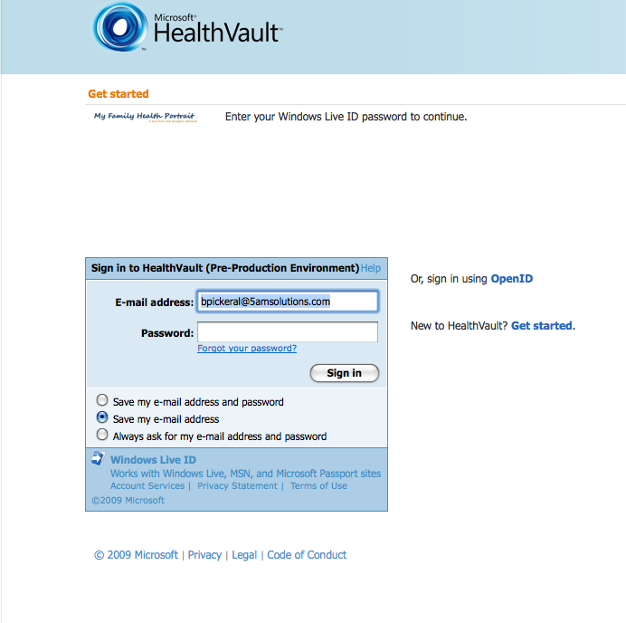

Slide 21
Microsoft HealthVault Manager
Save My Family History
You are now connected to the Microsoft HealthVault account for [proband name]. Click below to save your Family Health History information.
Save My Family History
Cancel

Slide 22

Microsoft HealthVault Manager
Save My Family History
Your Family Health History information has been saved to the Microsoft HealthVault account for [proband name].
Continue

Slide 23
Open a Saved Family History

Slide 24
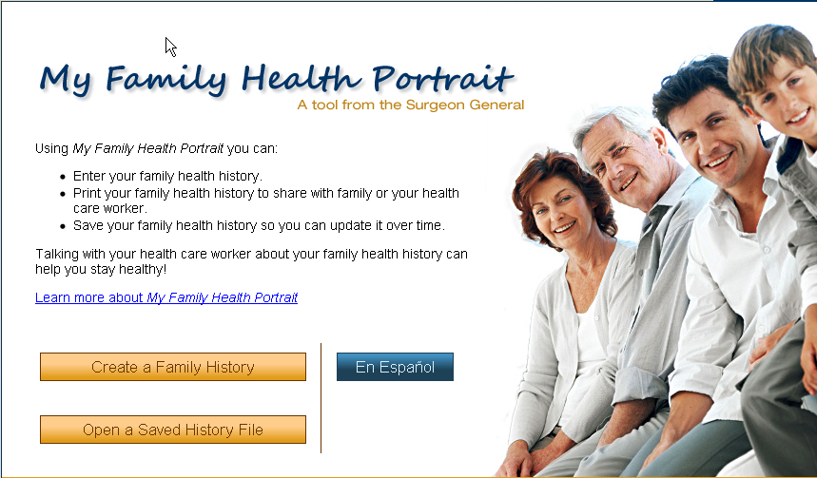
Change to HOME screen
New button text
Create a New Family History
Open a Saved Family History

